Slide 2
In the first year of Darius the son of Ahasuerus, of the lineage of the Medes, who was made king over the realm of the Chaldeans…
…in the first year of his reign I, Daniel, understood by the books the number of the years specified by the word of the LORD through Jeremiah the prophet…
…that He would accomplish seventy years in the desolations of Jerusalem.

Slide 3
Introducing…
Daniel’s
Seventy Weeks

Slide 4
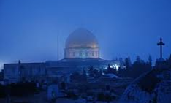
Daniel’s 70 Weeks
Israel: God’s clock
Thus, God revealed His plan to Daniel that He would begin counting 70 weeks on the nation of Israel, making Israel God’s prophetic clock for all of mankind.
The 70 weeks referred to was in all actuality 70 sevens (the Hebrew word for sevens was translated here as “weeks.” So, in other words God was going to count against Israel 70 sevens (70x7) which equals 490 years. These 490 years were to be broken into 3 periods of time as we shall see.

Slide 5
Daniel’s 70 Weeks
Israel: God’s clock
The following example from the story of Jacob and Rachel reveals how that the Hebrew word for “week” may refer to a period of seven years.
“…And Jacob loved Rachel; and said, I will serve thee seven years for Rachel thy younger daughter…” Genesis 29:18
“… Fulfil her week, and we will give thee this also for the service which thou shalt serve with me yet seven other years…” Genesis 29:27

Slide 6
Daniel’s 70 Weeks
Israel: God’s clock
“Seventy weeks [ seventy sevens] are determined [sectioned off] upon thy people and upon thy holy city…”
“…And thou shalt number seven sabbaths of years unto thee, seven times seven years; and the space of the seven sabbaths of years shall be unto thee forty and nine years…” Leviticus 25:8

Slide 7
Daniel’s 70 Weeks
Israel: God’s clock
“Seventy weeks [sevens] are determined [sectioned off] upon thy people and upon thy holy city…”
❶
“… to finish [put an end to, complete] the transgression …”
The “transgression” of Israel was brought to a completion with her rejection of Jesus. She is currently living in the shadow of that transgression.
“And for this cause he is the mediator of the new testament, that by means of death, for the redemption of the transgressions that were under the first testament, they which are called might receive the promise of eternal inheritance.” Hebrews 9:15
“Then answered all the people, and said, His blood be on us, and on our children.” Matthew 27:25
“But his citizens hated him, and sent a message after him, saying, We will not have this man to reign over us…” Luke 19:14

Slide 8
Daniel’s 70 Weeks
Israel: God’s clock
“Seventy weeks [sevens] are determined [sectioned off] upon thy people and upon thy holy city…”
❷
“… to make an end of sins…”
Literally, to seal or close up. Israel’s sins were as a running sores, yet God will one day stop the issue of sinfulness.
“From the sole of the foot even unto the head there is no soundness in it; but wounds, and bruises, and putrifying sores: they have not been closed, neither bound up, neither mollified with ointment.” Isaiah 1:6
“…though your sins be as scarlet, they shall be as white as snow …” Isaiah 1:18

Slide 9
Daniel’s 70 Weeks
Israel: God’s clock
“Seventy weeks [sevens] are determined [sectioned off] upon thy people and upon thy holy city…”
❸
“… to make reconciliation for iniquity…”
That is, to make atonement for sin. God sees in Israel’s future a restored relationship with Himself.
37 “Behold, I will gather them out of all countries, whither I have driven them in mine anger, and in my fury, and in great wrath; and I will bring them again unto this place, and I will cause them to dwell safely: 38 And they shall be my people, and I will be their God.” Jeremiah 32:37, 39 (see: vs. 37-42)
25 “For I would not, brethren, that ye should be ignorant of this mystery, lest ye should be wise in your own conceits; that blindness in part is happened to Israel, until the fulness of the Gentiles be come in. 26 And so all Israel shall be saved: as it is written, There shall come out of Sion the Deliverer, and shall turn away ungodliness from Jacob: 27 For this is my covenant unto them, when I shall take away their sins.” Romans 11:25-27

Slide 10
Daniel’s 70 Weeks
Israel: God’s clock
Israel: God’s clock
“Seventy weeks [sevens] are determined [sectioned off] upon thy people and upon thy holy city…”
❹
“…and to bring in everlasting righteousness…”
Israel would never on her own reach a state of righteousness with God. Therefore, God must perform a final work in Israel to bring them to Him.
“And I will pour upon the house of David, and upon the inhabitants of Jerusalem, the spirit of grace and of supplications: and they shall look upon me whom they have pierced, and they shall mourn for him, as one mourneth for his only son, and shall be in bitterness for him, as one that is in bitterness for his firstborn.” Zechariah 12:10

Slide 11
Daniel’s 70 Weeks
Israel: God’s clock
Israel: God’s clock
“Seventy weeks [sevens] are determined [sectioned off] upon thy people and upon thy holy city…”
❹
“…and to bring in everlasting righteousness…”
Jesus is the Righteous One of God. The only One Who qualifies for that status! Our righteousness must be imputed since we are not inheritantly so.
15 “Which in his times he shall shew, who is the blessed and only Potentate, the King of kings, and Lord of lords; 16 Who only hath immortality, dwelling in the light which no man can approach unto; whom no man hath seen, nor can see: to whom be honour and power everlasting. Amen.” 1 Timothy 6:15, 16
“But of him are ye in Christ Jesus, who of God is made unto us wisdom, and righteousness, and sanctification, and redemption:” 1 Corinthians 1:30
“My little children, these things write I unto you, that ye sin not. And if any man sin, we have an advocate with the Father, Jesus Christ the righteous.” 1 John 2:1

Slide 12
Daniel’s 70 Weeks
Israel: God’s clock
Israel: God’s clock
“Seventy weeks [sevens] are determined [sectioned off] upon thy people and upon thy holy city…”
❺
“…and to seal up the vision and prophecy…”
All such prophecy and visions will find their summation with the coming of Jesus, Who is the Sum and Substance thereof.
The phrase “to seal up” is from the same word as “to make an end of” as seen earlier in this verse. “Vision and prophecy” point to Divine revelation. Daniel’s prayer was an acknowledgment of God’s ability to make things happen as He foretold (Daniel 9:11-14).
“And I fell at his feet to worship him. And he said unto me, See thou do it not: I am thy fellowservant, and of thy brethren that have the testimony of Jesus: worship God: for the testimony of Jesus is the spirit of prophecy.” Revelation 19:10

Slide 13
Daniel’s 70 Weeks
Israel: God’s clock
Israel: God’s clock
“Seventy weeks [sevens] are determined [sectioned off] upon thy people and upon thy holy city…”
❻
“…and to anoint the most holy [place]…”
Literally, this verse reads, “to consecrate to divine service a holy of holies.” The phrase “most holy” is found 39 times in Scripture, and always refers to the tabernacle or to the temple. It is God’s desire to set up the “tabernacle of David” which had fallen down. This end-goal includes the inclusion of Gentiles qualified to rule in God’s theocracy (Acts 15:13-18).
2 “And I John saw the holy city, new Jerusalem, coming down from God out of heaven, prepared as a bride adorned for her husband. 3 And I heard a great voice out of heaven saying, Behold, the tabernacle of God is with men, and he will dwell with them, and they shall be his people, and God himself shall be with them, and be their God.” Revelation 21:2, 3

Slide 14
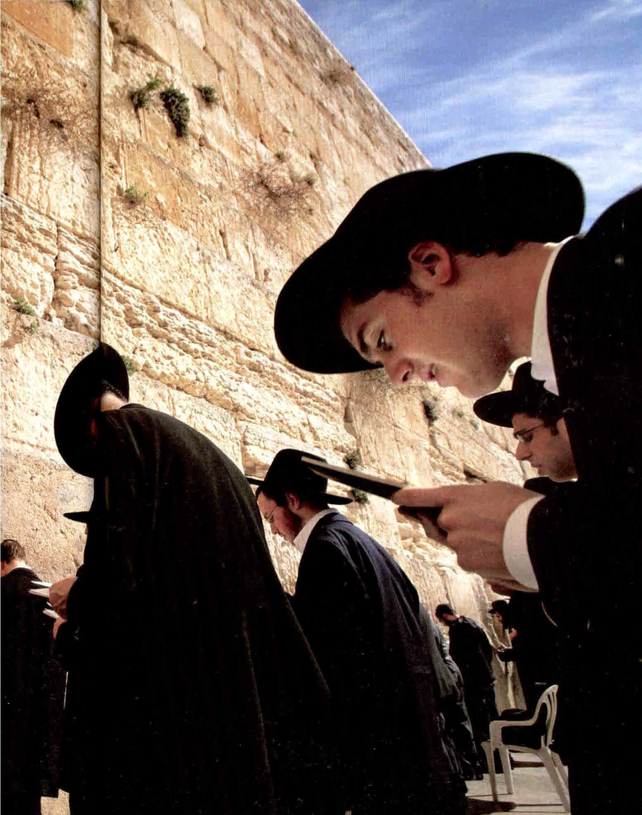
Daniel’s 70 Weeks
Israel: God’s clock
“Seventy weeks are determined upon thy people and upon thy holy city…”
PROPHETIC “WEEKS”
7
62
Church Age
1
WEEKS
WEEKS
WEEK
49
434
2000
7
YEARS
YEARS
YEARS

Slide 15
Daniel’s 70 Weeks
Israel: God’s clock
Daniel 9:25
Commandment to “restore and rebuild” Jerusalem
Nehemiah 2:1-8
Daniel 9:25
“…unto Messiah the prince”
“…shall be 7 weeks and 62 weeks”
Daniel 9:26
“After 62 weeks shall Messiah be cut off”
Daniel 9:27
“…and he shall confirm a covenant with many for one week…”
7
62
Church Age
1
WEEKS
WEEKS
WEEK
49
434
2000
7
YEARS
YEARS
YEARS

Slide 16
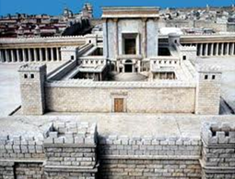
Daniel’s 70 Weeks
Israel: God’s clock
“Seventy weeks [sevens] are determined [sectioned off] upon thy people and upon thy holy city…”
There were actually 4 decrees (however, the first three are considered by some as one since they all dealt with the rebuilding of the temple.
14 “And the elders of the Jews builded, and they prospered through the prophesying of Haggai the prophet and Zechariah the son of Iddo. And they builded, and finished it, according to the commandment of the God of Israel, and according to the commandment of Cyrus, and Darius, and Artaxerxes king of Persia. 15 And this house was finished on the third day of the month Adar, which was in the sixth year of the reign of Darius the king. ” Ezra 6:14, 15

Slide 17
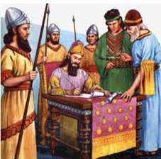
Daniel’s 70 Weeks
Israel: God’s clock
“Seventy weeks [sevens] are determined [sectioned off] upon thy people and upon thy holy city…”
The last decree by Persian king Artaxerxes, was to build the city and its walls.
Such decree was in his 20th year (taking office March 14, 465 B. C.) thus making the decree March 14, 445 B. C. (Nehemiah 2:1-8)

Slide 18
Daniel’s 70 Weeks
Israel: God’s clock
Daniel 9:25
Commandment to “restore and rebuild” Jerusalem
Nehemiah 2:1-8
This period of 49 years undoubtedly was sandwiched between Zerubbabel’s return with approximately 50,000 Jews and the complete rebuild of Jerusalem’s walls and second temple.
7
WEEKS
During which time, the Jews were met with great resistance from Gentiles living in the area.
49
During which time, the Lord sent Haggai and Zechariah to encourage the Jews to finish the work.
YEARS

Slide 19
Daniel’s 70 Weeks
Israel: God’s clock
Daniel 9:25
“…unto Messiah the prince”
“…shall be 7 weeks and 62 weeks”
This period of 434 years included the so-called “silent” years wherein God no longer sent prophets to Israel.
During which time, the Grecian empire grew under Alexander the Great (the kingdom of bronze and the kingdom depicted by the leopard with 4 wings. It also includes the Roman empire.
62
WEEKS
Other such noteworthy events took place during this time, such as…
280-200 B.C. -- The translation of the LXX (Septuagint)
200 B.C. – The Great wall of China was built
167 B.C. – The Greek tyrant, Antiochus Epiphanes defiled the temple by offering a pig on the altar, and persecuted the Jews.
20 B.C. – King Herod remodeled the 2nd temple
434
YEARS

Slide 20
Daniel’s 70 Weeks
Israel: God’s clock
Daniel 9:26
“After 62 weeks shall Messiah be cut off”
It was during this stretch of time that Israel’s Messiah the Prince was to come.
However, as time marched on Israel became legalistic under their reformed nationalism. The Pharisees and Sadducees and Scribes had forged the spiritual temperamentrof the nation.
62
Amidst a nation hardened by sin and blindness, Jesus finally publically identified Himself as their Messiah when He rode into Jerusalem on the foal of a donkey. Later that week, Messiah was crucified (“cut off”) as foretold. He left no kingdom, only His ekklesia to preach of His 2nd coming.
WEEKS
Eventually, their Messiah is born of a woman in the house of David as foretold. He grew in favor with God and with man until the time of His showing to Israel.
434
YEARS

Slide 21
Daniel’s 70 Weeks
Israel: God’s clock
Daniel 9:26
“and the people of the prince that shall come shall destroy the city and the sanctuary”
Daniel foretold of the destruction of the temple by the “people” of a prince. Much speculation has been made as to whom this “prince” would be. It appears that he will turn out to be the “antichrist.”
62
However, the antichrist doesn’t destroy the temple, but rather sits in the temple. It must be then that a separation of time takes place between the people destroying the temple and a future “prince” to whom they are the ancestors of should come.
WEEKS
It is a well known fact that the “people” who destroyed the temple in 70 A.D. were mostly Arabs and Syrians serving in the Roman army. And from our previous studies, we noted that the antichrist will emerge from such – he will be from Assyria.
434
YEARS

Slide 22
Daniel’s 70 Weeks
Israel: God’s clock
Daniel 9:27
“And he shall confirm the covenant with many for one week: and in the midst of the week he shall cause the sacrifice and the oblation to cease”
However, the antichrist doesn’t destroy the temple, but rather sits in the temple. He commits an abomination (Matthew 24:15 ; 2 Thessalonians 2:4) .
1
Jesus forecasts this future event as that which will be the worst ever in human history with regard to persecution (Matthew 24:21).
WEEK
In the midst of this last “week” of seven years, the antichrist will break a covenant that had been made and confirmed (Daniel 12:7).
7
He will go after the “woman” as well as the “remnant of her seed” (Revelation 12:14-17). He will meet up with a returning Jesus only to be finally destroyed (Revelation 19:20).
YEARS

Slide 23
The End
(of days)

